Slide 1

The case for investment in mental health
Mental Health Day 2021

Slide 2
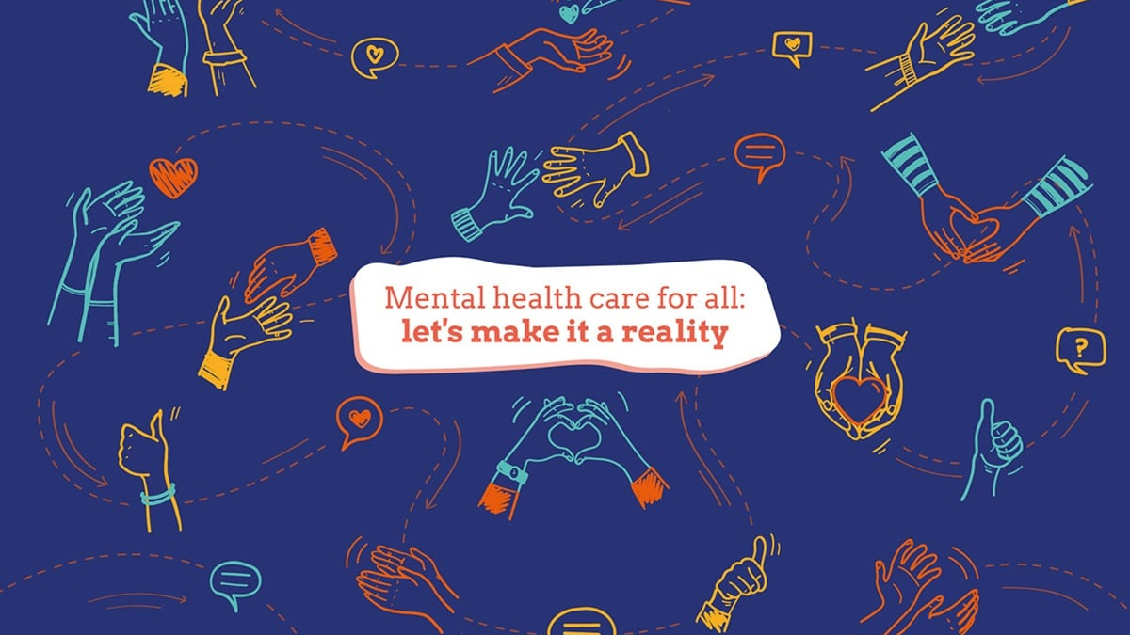
World Mental Health Day 2021

Slide 3
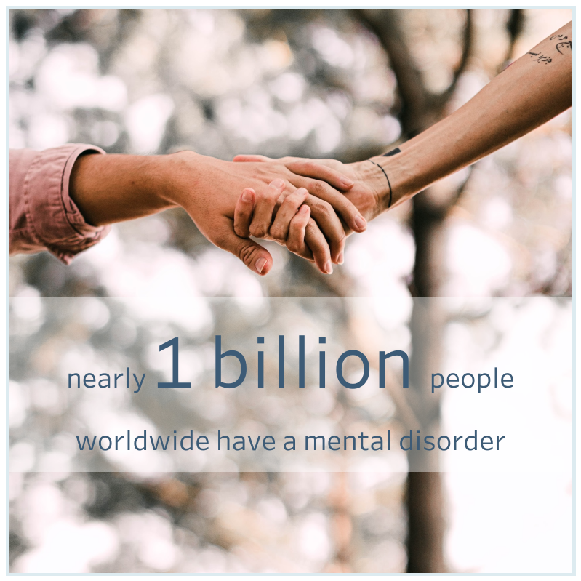
World Mental Health Day
Close to one billion people have a mental disorder and anyone, anywhere, can be affected.
That’s 1 in 8 people worldwide.

Slide 4
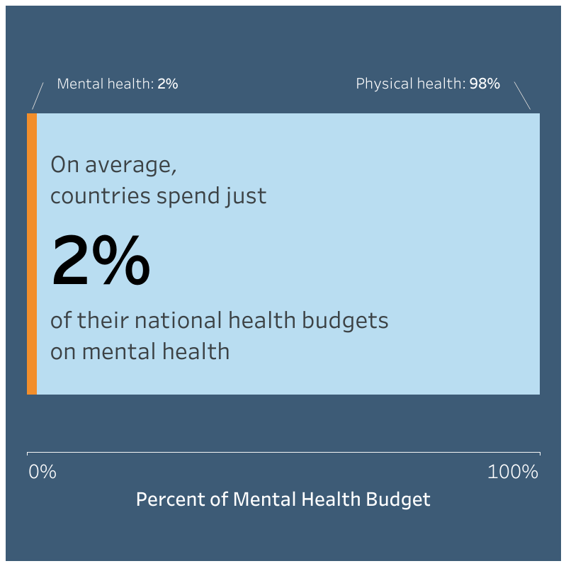
World Mental Health Day
The gap between demand for mental health services and supply remains substantial.
On average, countries spend just 2% of their national health budgets on mental health. This has changed little in recent years.

Slide 5
The Proposal

Slide 6
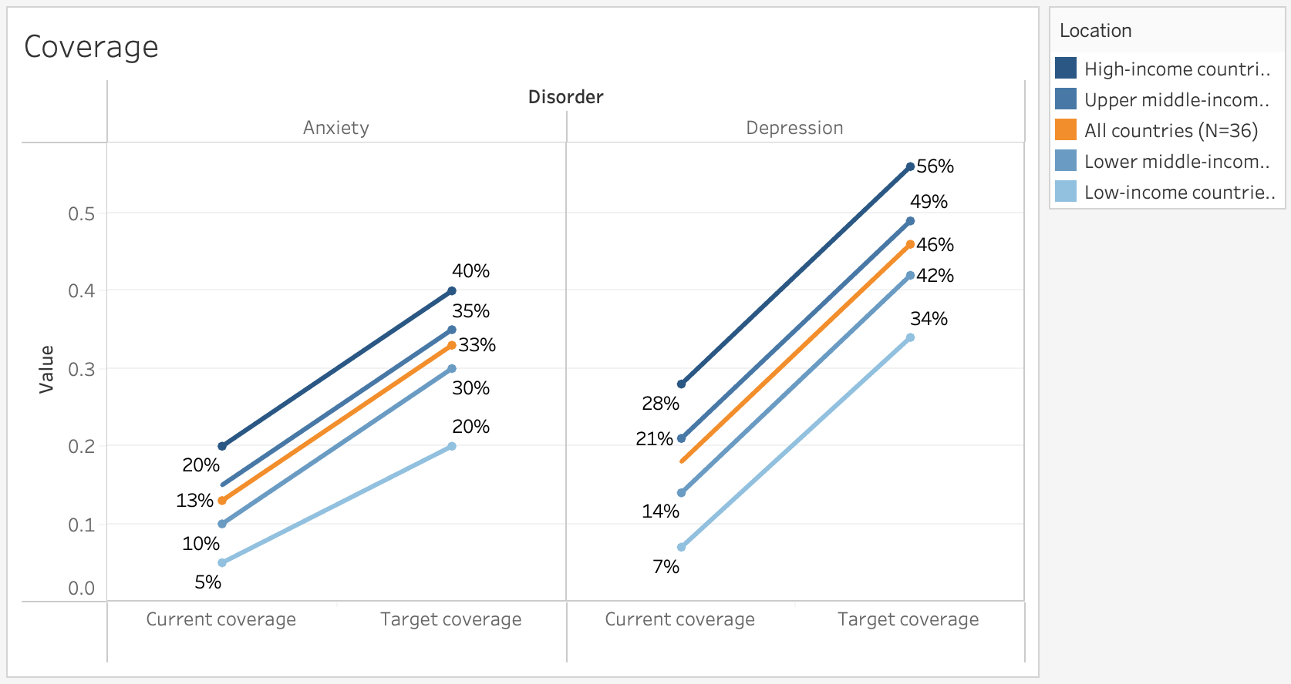
Raise the treatment coverage by 20% for anxiety and depression in 36 countries

Slide 7
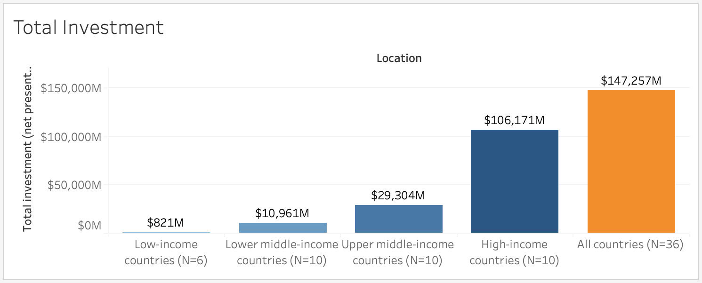
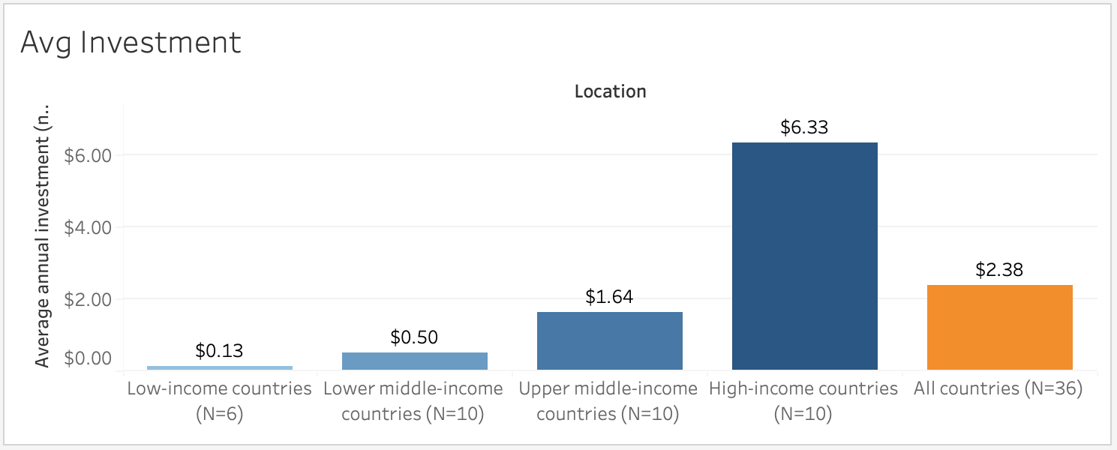
An investment of US $147B to substantially scale up treatment

Slide 8
The Benefits

Slide 9
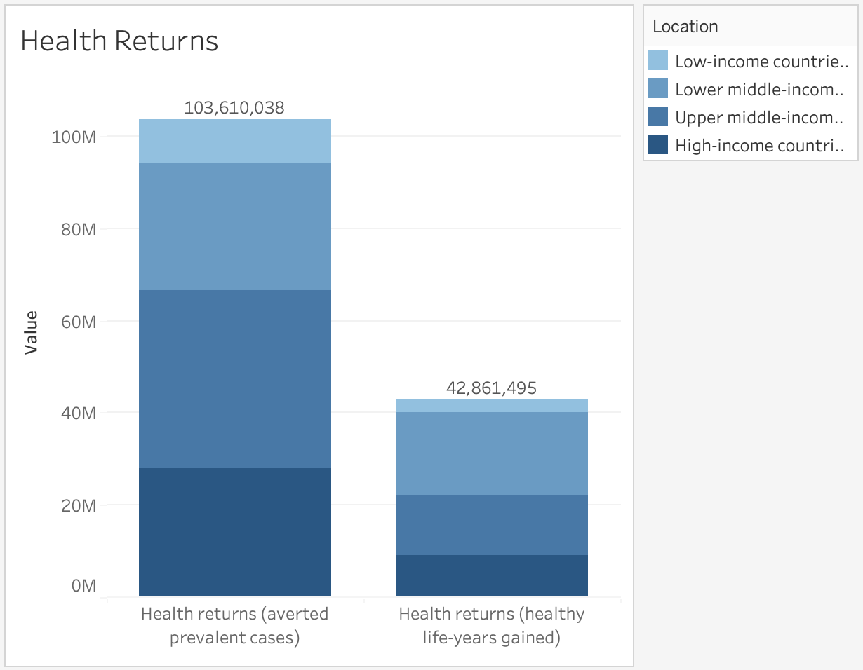
Prevent 104M cases and gain 42M of healthy life years from 2016-2030

Slide 10
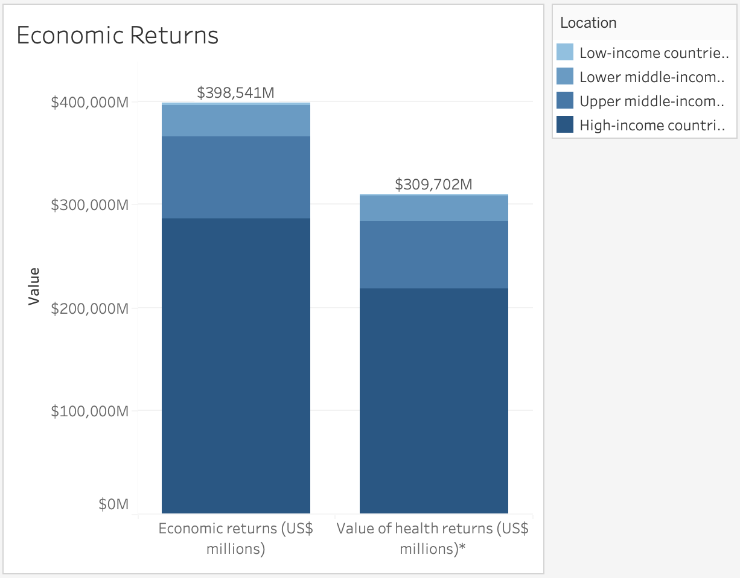
Total value of $708B in economic returns

Slide 11
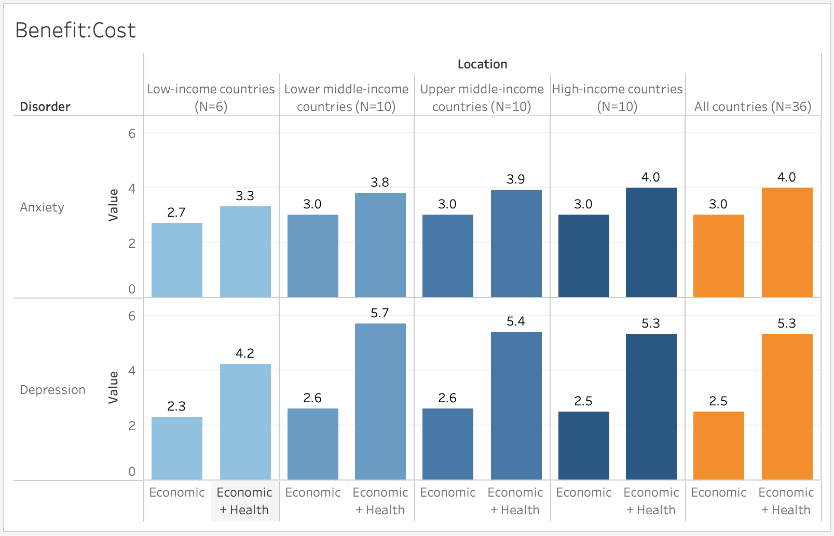
Benefit:cost ratio for both benefits is 4.2-5.7 for depression and 3.3-4.0 for anxiety

Slide 12
Your help

Slide 13
Invest in the health of your world
The full spectrum of mental health needs should be met through a community-based network of accessible, affordable and quality services and supports.
We shine a light on the people who need it most.
Now is the time to sustainably finance WHO and invest in a healthy return for all.
Your donation makes all the difference.
Closing the mental health treatment gap

Slide 14

Without mental health there can be no true physical health.

Slide 15
Thank you

